Slide 1
Implementing HTTPS Servers and Clients
P. Grishm Kumar
22H51A05Q9

Slide 2

Introduction to HTTPS
HTTPS stands for Hypertext Transfer Protocol Secure and is an extension of HTTP.
It uses SSL/ TLS protocols to encrypt data transmitted between clients and servers.
Implementing HTTPS is essential for securing sensitive information, enhancing user trust, and improving SEO rankings.

Slide 3
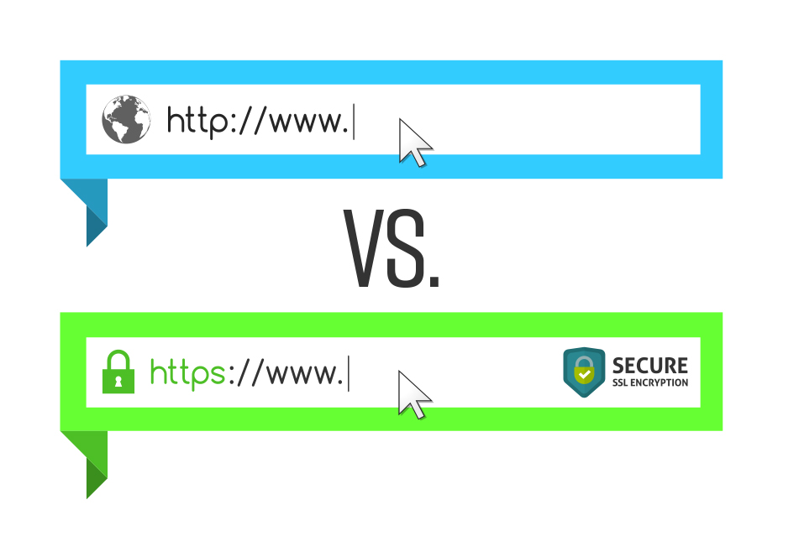
HTTPS vs HTTP
HTTPS (Secured):
Encrypts data between server and client.
Uses certificates to verify authenticity.
HTTP (Unsecured):
Communication is in plaintext, vulnerable to interception.
No encryption, verification of the server.

Slide 4
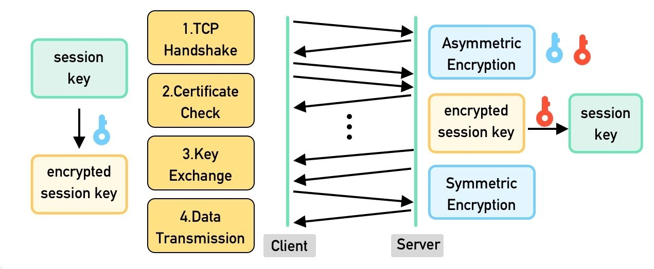
Components of HTTPS
SSL/TLS Protocol:
Secure Sockets Layer (SSL) / Transport Layer Security (TLS).
Encrypts data in transit.
Certificates:
Issued by Certificate Authorities (CAs).
Public-private key pairs for encryption.

Slide 5
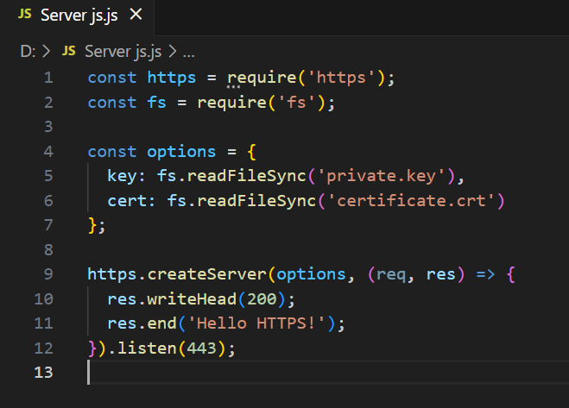
Setting Up HTTPS Server
Example (Node.js)
Generate SSL Certificate
Use tools like OpenSSL or services like Let’s Encrypt.
Command: openssl req -x509 -nodes -days 365 -newkey rsa:2048 -keyout private.key -out certificate.crt
Configure Server for HTTPS
Update server configuration (e.g., Nginx, Apache, Node.js) to support HTTPS.

Slide 6
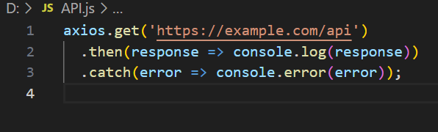
Implementing HTTPS on Client Side
Web Browsers (Clients):
Automatically handle HTTPS communication if the server is properly configured.
API Calls:
Make secure API requests using HTTPS in JavaScript (e.g., Axios, Fetch).

Slide 7
Tools for SSL/TLS Management
Full Stack Integration
Let’s Encrypt:
Free, automated, and open Certificate Authority.
Tool: Certbot for auto-renewing SSL certificates.
SSL Labs:
Check the security of your SSL setup.
Backend:
Implement secure data handling with HTTPS for APIs, databases, and user authentication.
Frontend:
Ensure all front-end resources (images, scripts, fonts) load over HTTPS.
Use Content Security Policy (CSP) headers for added security.

Slide 8




Real-World Examples
Common Use Cases:
E-commerce websites.
Banking applications.
Social networks (data-sensitive platforms).

Slide 9
THANK YOU

